Slide 1
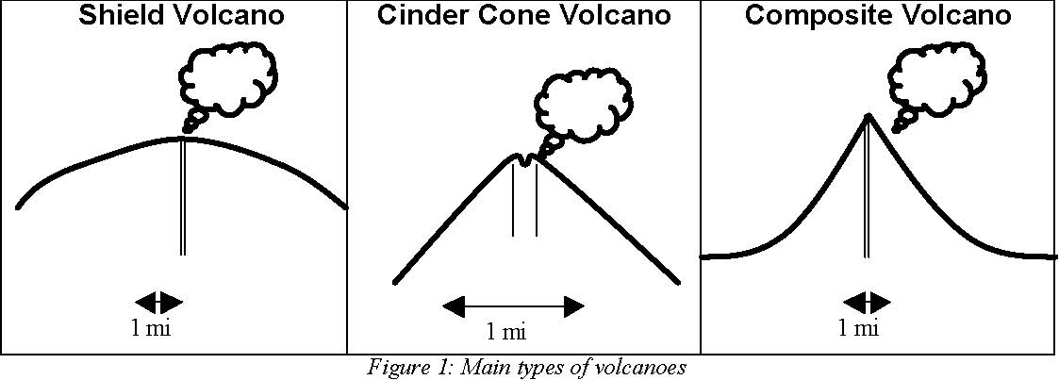

Slide 2
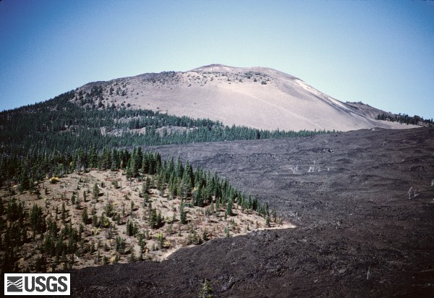
Type A

Slide 3
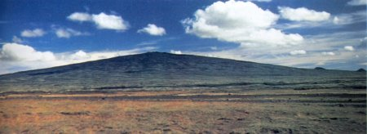
Type A

Slide 4
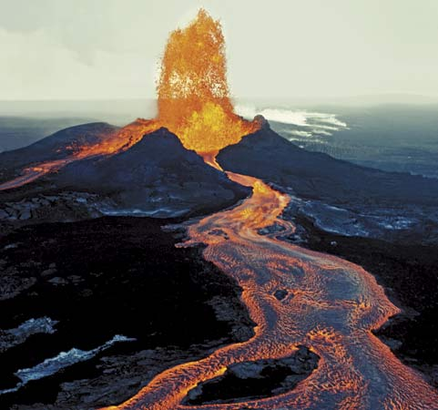
Type A

Slide 5
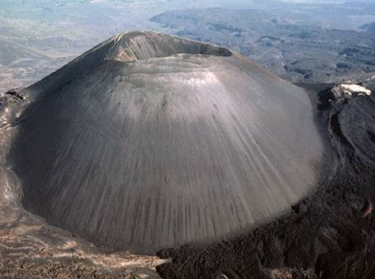
Type B

Slide 6
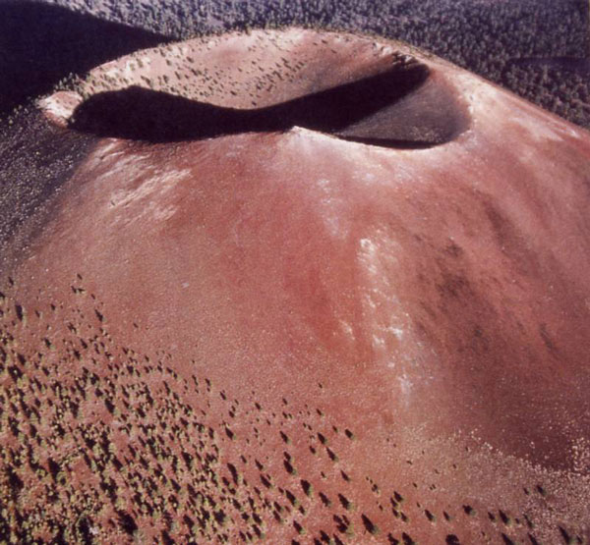
Type B

Slide 7
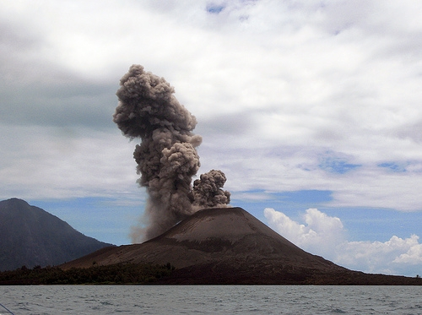
Type B

Slide 8
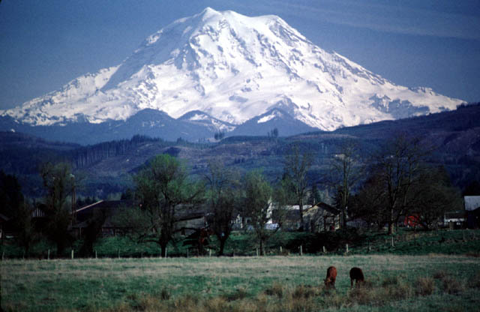
Type C

Slide 9
Type C

Slide 10
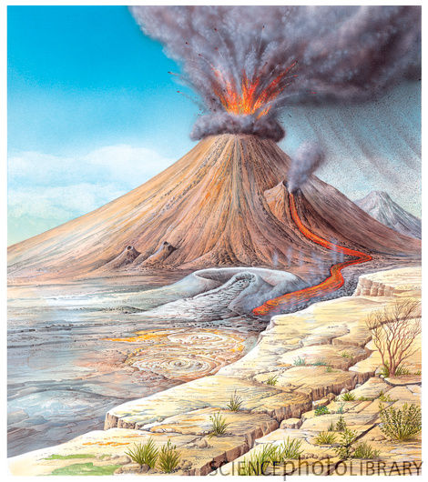
Type C

Slide 11
What are the differences and similarities?
Type B
Type A
Type C

Slide 12
Types of Volcanoes
There are 3 types of Volcanoes:
Shield
Cinder Cone
Composite
They are
classified by
how they form.

Slide 13
Shield Volcano
Is wide and somewhat flat.
It forms from a quiet eruption.
Lava flows out quietly and for great distances.

Slide 14
Cinder Cone Volcano
Has tall, very steep sides.
Has explosive eruptions.
This eruption produces a lot of cinder and ash.

Slide 15
Composite Volcano
Form from explosive eruptions.
Produce a lot of lava and ash.
Is small, with steep sides.

